Slide 1

Exploratory Data Analysis:Loan Default Risk Assessment
Identifying Patterns to Minimize Financial Risk in Loan Approvals
Name:-Aditya Pachlangia
Date :-May 28,2025
Course:-Professional Certificate Program in AI and Data Science

Slide 2
Explain the Business Problem and Objectives
Problem Statement:-When the company receives a loan application,the company has to decide on loan approval based on the application’s profile.Two types of risks are associated with the bank’s decision:
If the applicant is likely to repay the loan, then not approving the loan result in a loss of business for the company.
If the applicant is not likely to repay the loan, i.e. he/she is likely to default, then approving the loan may lead to a financial loss for company.
Objective:-Use EDA to identify patterns in loan application data to predict clients with payment difficulties ,minimizing financial risk for a consumer finance company.

Slide 3

Key Risk:-
Approving loans for clients likely to default = Financial Loss
Denying loans to capable clients = Lost Business
Data Overview:-
application_data.csv: Client info at the time of application (e.g. income,education).
previous_application.csv: Past loan data
(e.g. Approved,Refused).
Target Variable:TARGET(1=Payment difficulties,
0=No difficulties).

Slide 4
Approach and Methodology
Load and inspect datasets
Handle missing values and outliers
Analyze data imbalance in target variables
Perform univariate and bivariate analysis
Merge with previous application data for insights
Summarize finding with visualizations
Load Data
Clean Data
Analyze Imbalance
Univariate & Bivariate Analysis
Summarize Finding
Merge with Previous Data

Slide 5
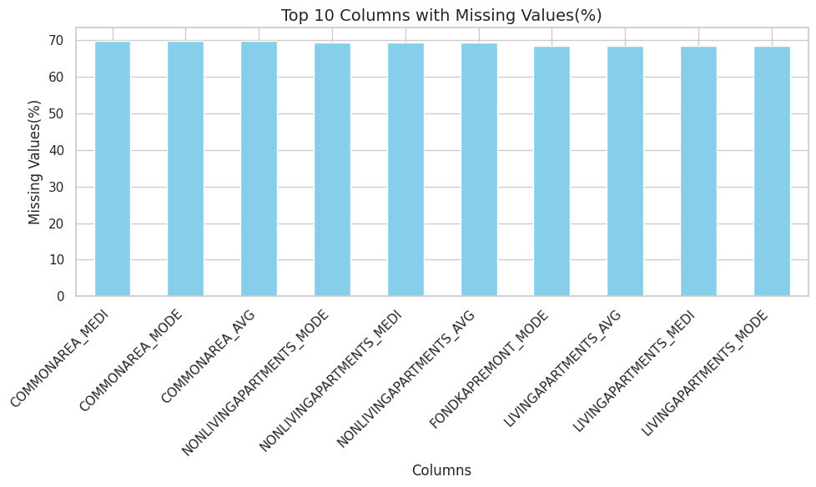
Data Cleaning:Handling Missing Values
Identified columns with missing values (e.g. some columns had up to 60% missing data).
Strategy:-
Dropped columns with >50% missing values
to avoid bias.
Filled numerical columns with median
(e.g. AMT_INCOME_TOTAL).
Filled categorical columns with mode
(e.g. NAME_EDUCATION_TYPE).
Result:- No missing values remain in the dataset.

Slide 6
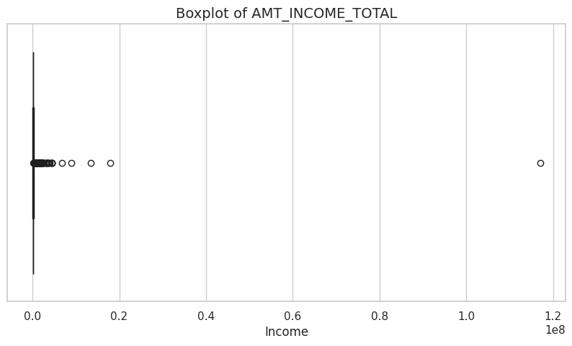
Data Cleaning: Outliers Analysis
Used IQR method to detect outliers in numerical columns.
Example:- AMT_INCOME_TOTAL(income) had high-income outliers.
Decision:- Retained outliers as they may represent valid cases(e.g. Wealthy clients).

Slide 7
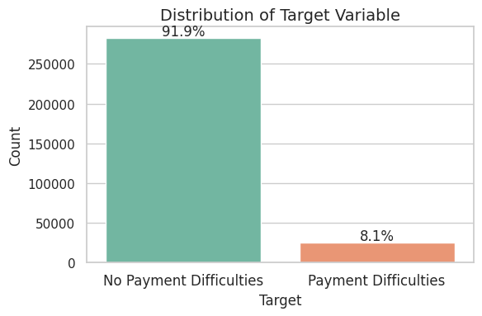
Target Variable Distribution (Imbalance)
TARGET distribution:-
0(No Payment difficulties):~90%
1(Payment difficulties):~10%
Insight:- Imbalanced dataset; need to focus on features that differentiate the minority class.

Slide 8
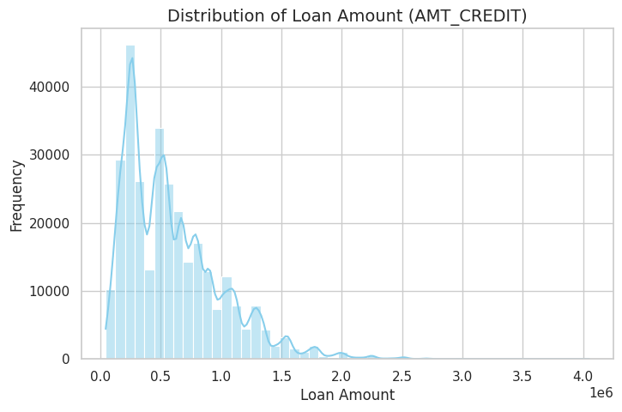
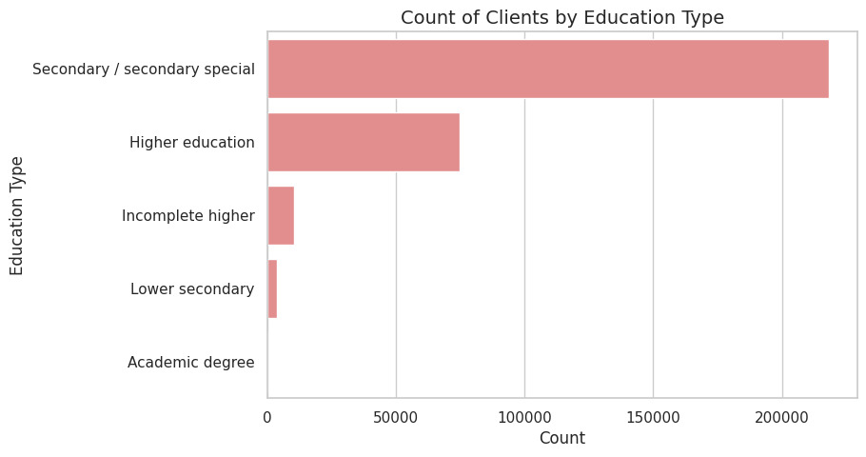
Univariate Analysis: Understanding Distributions
Numerical: AMT_CREDIT (Loan Amount)
Right-skewed distribution; most loans are small.
Categorical: NAME_EDUCATION_TYPE
Most clients have Secondary education.

Slide 9
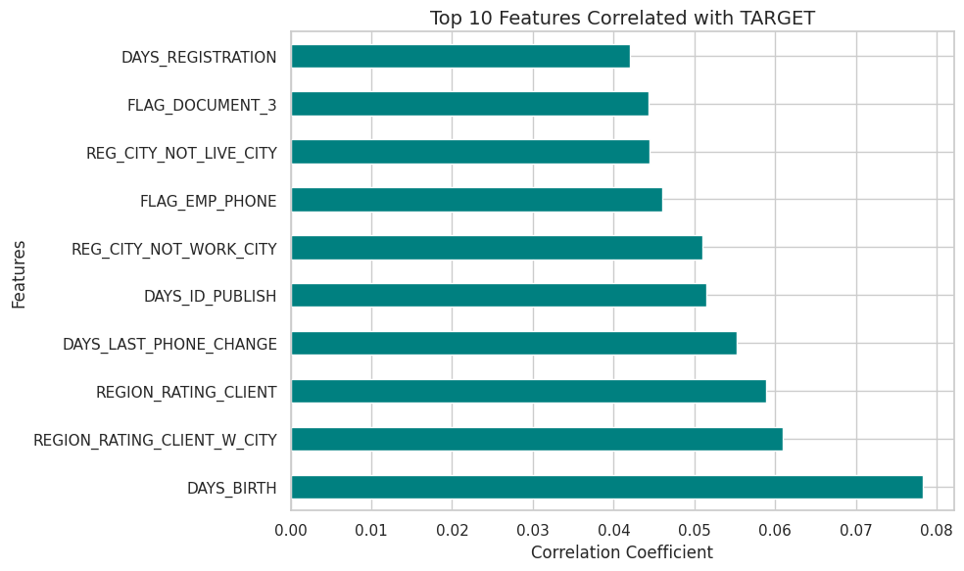
Bivariate Analysis: Top Correlations with TARGET
Top features correlated with TARGET:
DAYS_BIRTH (negative): Older clients are less likely to default.
EXT_SOURCE_3 (negative): Better external scores reduce default risk.
DAYS_LATE (positive): Past late payments increase default risk.

Slide 10
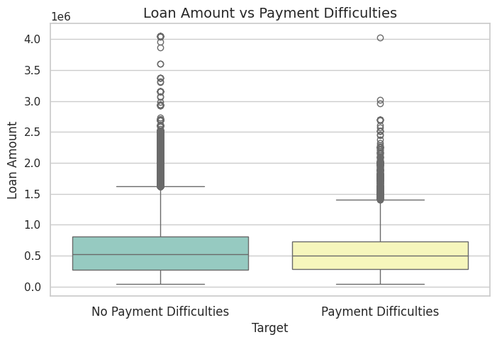
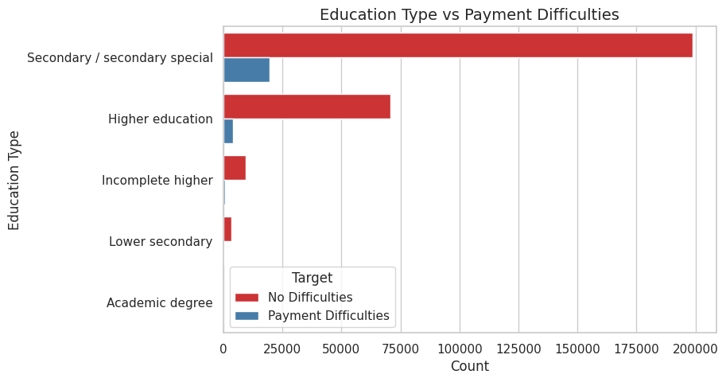
Bivariate Analysis: Segmentation Insights
Loan Amount vs Payment Difficulties:
Clients with payment difficulties have slightly lower loan amounts.
Education vs Payment Difficulties:
Lower education (e.g., Secondary) linked to higher default risk.

Slide 11
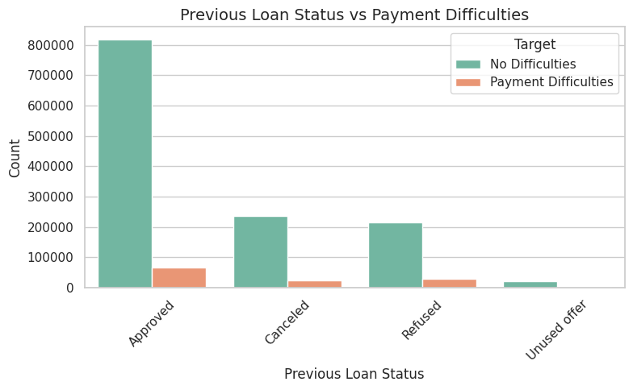
Insights from Previous Applications
Merged application_data with previous_application to analyze past loan outcomes.
Finding: Clients with previous loans marked "Refused" have a higher likelihood of payment difficulties.

Slide 12

Key Insights
Clients with lower education (e.g., Secondary) are more likely to have payment difficulties.
Older clients (DAYS_BIRTH) and those with better external scores (EXT_SOURCE_3) are less likely to default.
Previous loan refusals correlate with a higher risk of payment difficulties.
Loan amounts for clients with payment difficulties are slightly lower, possibly indicating riskier loans.

Slide 13
Conclusion and Recommendations
Conclusion:
EDA identified key factors driving loan default risk: education, age, external scores, and past loan history.
Recommendations:
Deny or adjust terms (e.g., higher interest rates) for clients with lower education and past refusals.
Use EXT_SOURCE_3 as a strong indicator for loan approval decisions.
Next Step: Build a predictive model using these insights.

Slide 14
Thank You

